Slide 1
Introduction to Networks & IP Addressing
Introduction to Networks
Notes:
Cisco Networking Academy program
Introduction to Networks
Chapter 1: Exploring the Network

Slide 2
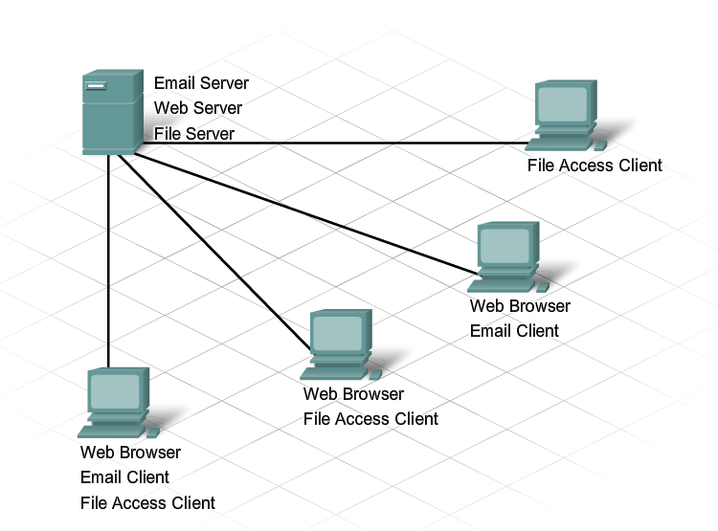
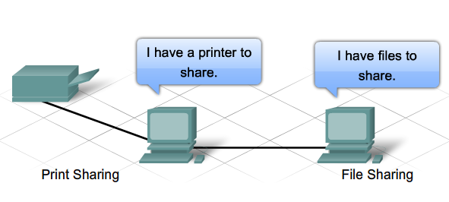
What is a Network ?
Network:
Enable Data Transfer among nodes.
→ More then two nodes
i.e. Home Network
Notes:
Section 1.1.2.1

Slide 3
LANs and WANs Types of Networks
The two most common types of network infrastructures are:
Local Area Network (LAN)
Wide Area Network (WAN).
Other types of networks include:
Metropolitan Area Network (MAN)
Wireless LAN (WLAN)
Storage Area Network (SAN)
Notes:
Section 1.2.2.1

Slide 4
LANs and WANs Local Area Networks (LAN)
Notes:
Section 1.2.2.2

Slide 5
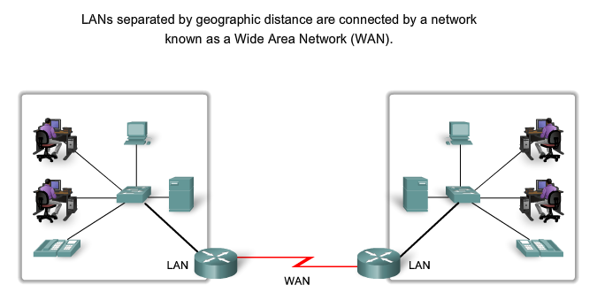
LANs and WANs Wide Area Networks (WAN)
Notes:
Section 1.2.2.3

Slide 6
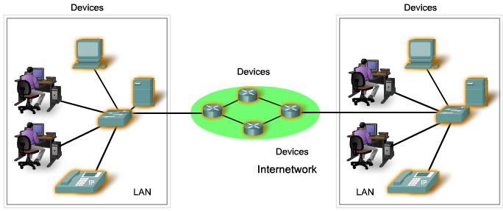
LANs, WANs, and Internets Components of a Network
There are three categories of network components:
Devices
Media
Services
Notes:
Section 1.2.1.1

Slide 7
LANs, WANs, and Internets Components of a Network
Devices
End Device:
Computers (work stations (i.e. Desktop ,Laptops), Servers)
Network printers
VoIP phones
TelePresence endpoint
Security cameras
Mobile handheld devices (such as smartphones, tablets, PDAs, and wireless debit / credit card readers and barcode scanners)
Notes:
Section 1.2.1.1

Slide 8
LANs, WANs, and Internets Components of a Network
Devices
Intermediate Device:
Network Access Devices
(switches, and wireless access points)
Internetworking Devices (Routers)
Security Devices (Firewalls)
Notes:
Section 1.2.1.1

Slide 9
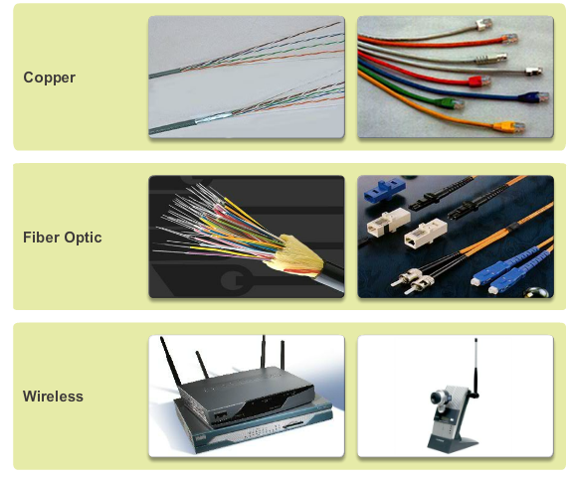
LANs, WANs, and Internets Components of a Network
Notes:
Section 1.2.1.4

Slide 10
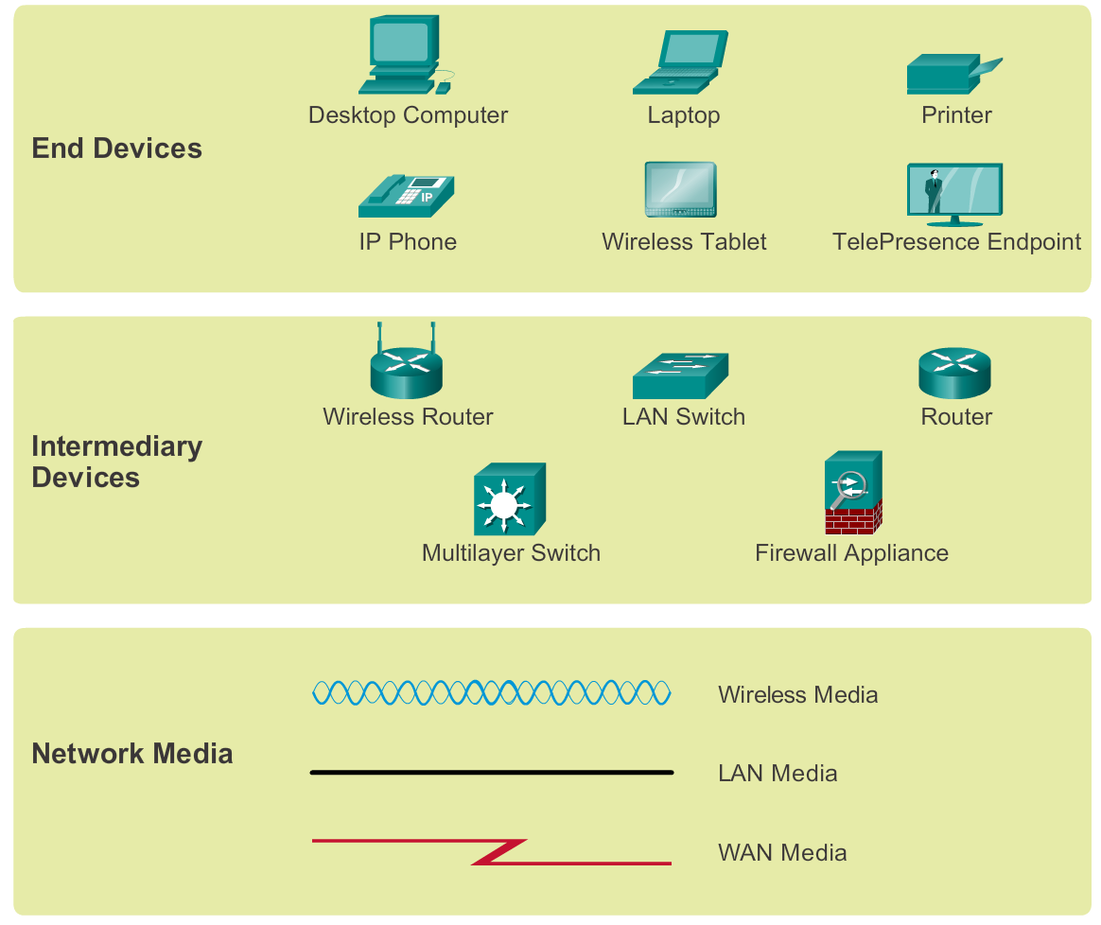
Components of a Network Network Representations
Notes:
Section 1.2.1.5

Slide 11
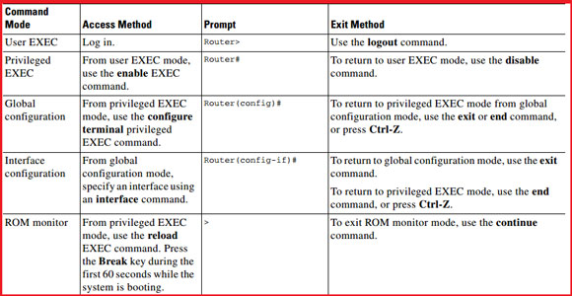
Network Architectures Cisco IOS(Internetwork Operating System)
→ IOS
→ IOS-X
Cisco ios modes of operation
Notes:
Section 1.4.4.2

Slide 12
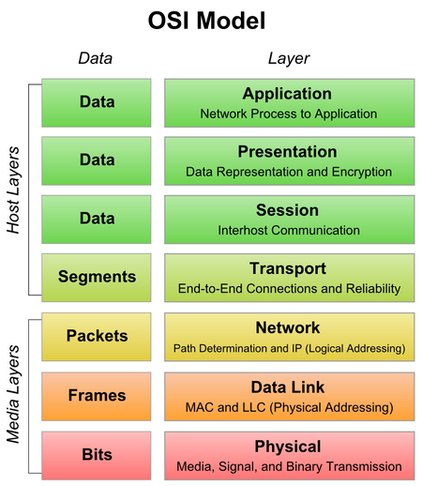
Components of a Network OSI Layer (Open Systems Interconnection)
Notes:
Section 1.2.1.5

Slide 13
Address
Two Type of in Computer Networks
1. Physical Address/MAC Address
→MAC (Media Access Control) is A Unique Identifier
→ 48bits Hexadecimal Address
→ Ex. 00:0a:95:9d:68:16
→ First Three Octets are Manufacturers ID
Dell: 00-14-22
Cisco: 00-40-96
2. Internet Protocol(IP)
Two Types of IP:
→ IPv4: Internet Protocol version 4
IPv4 Length: 32 bits
→ IPv6: Internet Protocol version 6
IPv6 Length: 128 bits
Notes:
Section 1.2.1.5

Slide 14
Internet Protocol (IP)
Type of IP:
→ IPv4: Internet Protocol version 4
IPv4 Length: 32 bits
→ IPv6: Internet Protocol version 6
IPv6 Length: 128 bits
IPv4 : Dotted Decimal Address
Ex. 192.168.10.0/24
IPv6 : Hexadecimal Address separated by colons (:)
Ex. 2001:0db8:85a3:0000:0000:8a2e:0370:7334/64
Notes:
Section 1.2.1.5

Slide 15
Internet Protocol version 4 (IPv4) : Public
Class | Start IP | End IP | Network Part | Host Part | Default Subnet Mask
A | 0.0.0.0 | 127.255.255.255 | 8 | 24 | 255.0.0.0
B | 128.0.0.0 | 191.255.255.255 | 16 | 16 | 255.255.0.0
C | 192.0.0.0 | 223.255.255.255 | 24 | 8 | 255.255.255.0
D | 224. 0.0.0 | 239.255.255.255 | Reserved for Multicasting
E | 240.0.0.0 | 255. 255.255.254 | Experimental; used for research
Notes:
Section 1.2.1.5

Slide 16
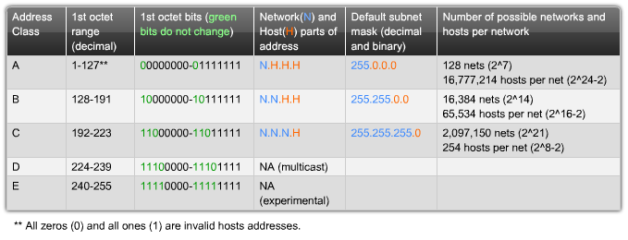
Internet Protocol version 4 (IPv4) : Public
Special Use:
Network Address: All Host bits are ‘0’
Broadcast Address: All Host bits are ‘1’
Loopback Address:
IPv4: 127.0.0.1/8 & IPv6: ::1
Link Local Address:
IPv4: 169.254.0.1/16 & IPv6: FE80::1
Notes:
Section 1.2.1.5

Slide 17
Internet Protocol version 4 (IPv4) : Private
Class | Start IP | End IP | Network Part | Host Part | Default Subnet Mask
A | 10.0.0.0 | 10.255.255.255 | 8 | 24 | 255.0.0.0
B | 172.16.0.0 | 172.31.255.255 | 16 | 16 | 255.255.0.0
C | 192.168.0.0 | 192.168.255.255 | 24 | 8 | 255.255.255.0
IP Address:
Network Address: All Host bits are ‘0’
Subnet Mask: All Network bits are ‘1’
Broadcast Address: All Host bits are ‘1’
Notes:
Section 1.2.1.5

Slide 18
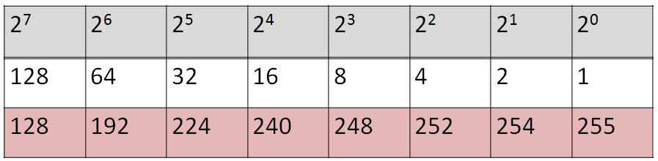
Internet Protocol version 4 (IPv4)
Class:
Default Network Address:
Default Subnet Mask:
Default Broadcast Address:
Subnet/Borrow Bit:
Prefix:
Network Address:
Custom Subnet Mask:
1st IP Address: Last IP Address:
Notes:
Section 1.2.1.5

